Slide 1
Move Instructions
© 2015 John Sefcovic

Slide 2
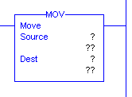
MOVE
The MOVE (MOV) is an output instruction when the rung conditions are true, will place a copy of the Source value, constant or reference Tag, into the Tag in the Destination.
Studio 5000

Slide 3
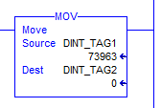
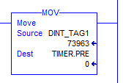
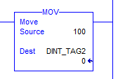
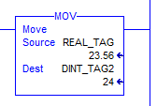
MOVE
ADDRESSING EXAMPLES RSLogix 5000
SOURCE: INTEGER
DESTINATION: INTEGER
SOURCE: INTEGER
DESTINATION: TIMER PRESET
SOURCE: CONSTANT VALUE
DESTINATION: INTEGER
SOURCE: REAL
DESTINATION:INTEGER
Note: Real number with decimal place is
rounded to whole number integer.

Slide 4
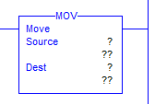
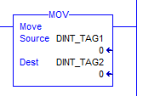
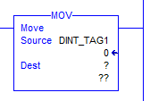
MOVE
Studio 5000
When the instruction is first entered, there are two sets of question marks for the Tag and tag value.
As the Tags are entered, the value stored at the tag is displayed.
The values may be entered in the instruction or the Studio 5000 Tag Table, Monitor tab.

Slide 5
MOVE
OPERATIONS
SOURCE
21,845 _{Decimal}
DESTINATION
BEFORE MOVE
DESTINATION
AFTER MOVE
21,845 _{Decimal}

Slide 6
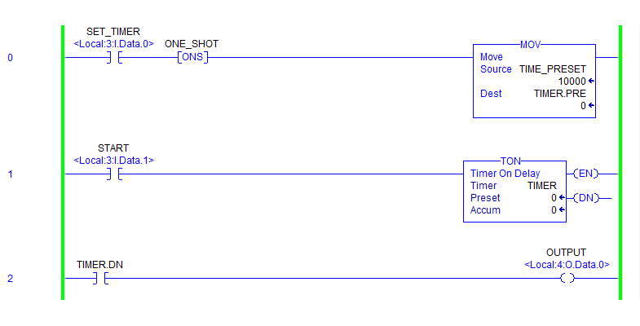
MOVE
The SOURCE is an Integer Tag with a value of 10000.
The DESTINATION is the Timer preset (.PRE).
10000
0
SOURCE
DESTINATION
TIME_PRESET
TIMER.PRE

Slide 7
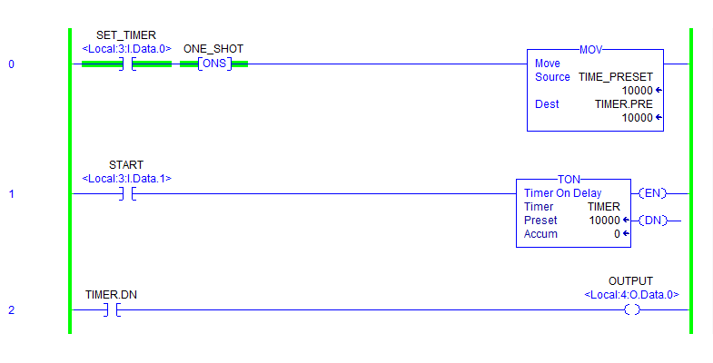
MOVE
When the rung is TRUE, the value of 10000 is moved into the timer’s preset setting the timer to 10 seconds.
10000
10000
SOURCE
DESTINATION
TIME_PRESET
TIMER.PRE

Slide 8
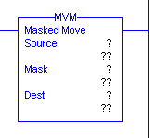
MOVE WITH MASK
The MOVE WITH MASK (MVM) is an output instruction when the rung conditions are true, the MVM instruction copies the data from a Source location to a Destination bit-by-bit.
Portions of the Destination data are masked by a separate hexadecimal word. data at the Source Tag passes through the Mask to the Destination Tag.
RSLogix 5000

Slide 9
MOVE WITH MASK
OPERATIONS – EXAMPLE 1
SOURCE
MASK
0 = prevent change
1 = allow change
DESTINATION
BEFORE MOVE
UNCHANGED
DATA MOVED
THROUGH MASK
DESTINATION
AFTER MOVE

Slide 10
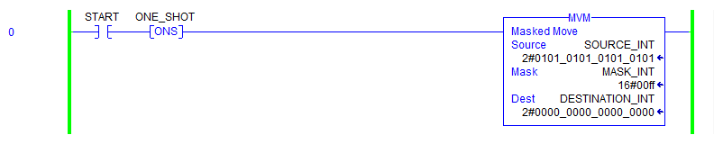
MOVE WITH MASK
Studio 5000
The bit pattern in the Source Tag is to be moved thru the Mask to the Destination Tag.

Slide 11
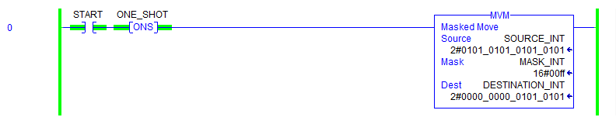
MOVE WITH MASK
Studio 5000
When the rung is TRUE, the contents of the lower byte of Source Tag is passed through the masked to the Destination Tag lower byte. The destination’s upper byte is unchanged due to being masked out.
The bits moved depends on the masking.

Slide 12
MOVE WITH MASK
OPERATIONS – EXAMPLE 2
SOURCE
MASK
1 = allow change
0 = prevent change
1 = allow change
DESTINATION
BEFORE MOVE
DATA MOVED
THROUGH MASK
UNCHANGED
DATA MOVED
THROUGH MASK
DESTINATION
AFTER MOVE

Slide 13
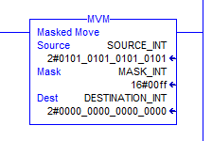
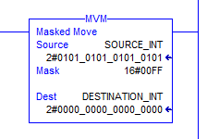
MOVE WITH MASK
DECIMAL | HEX | BINARY
0 | 0 | 0000
1 | 1 | 0001
2 | 2 | 0010
3 | 3 | 0011
4 | 4 | 0100
5 | 5 | 0101
6 | 6 | 0110
7 | 7 | 0111
8 | 8 | 1000
9 | 9 | 1001
10 | A | 1010
11 | B | 1011
12 | C | 1100
13 | D | 1101
14 | E | 1110
15 | F | 1111
The MASK value may be entered as a Tag...
In these examples, the MASK is in a Hex format.
…or the MASK value may be entered as a Constant.

Slide 14

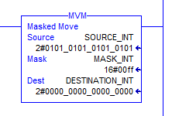
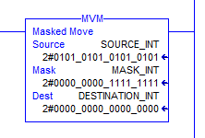

MOVE WITH MASK
In this example, the MASK value is in a Hex Style, displaying as a Hex number. Notice the prefix of 16#.
In this example, the MASK value is in a Binary Style, displaying as a Binary number. Notice the prefix of 2#.

Slide 15

MOVE WITH MASK
The MOV and MVM instruction buttons are in the Move/Logical.

